Slide 1
Exam 2 Analytics Q1
Andrew Fish

Slide 2
Balanced Book Hypothesis NFL
Market | Mean Percent Bets Placed
Over | 74.9%***
Under | 25.1%***
Home Spread | 44.4%***
Visitor Spread | 55.4%***
According to the Balanced Book Hypothesis there should be equal action on all sides of the betting market. In this case there are two sides for each market, Totals (Over/Under) and Spread (Home/Away)
Within the table above it is shown that there is an unbalance within each market. Totals are more unbalanced than Spread
Using a one sample t-test we were able to reject the null hypothesis that the means of the markets are different than 50%. All were found to reject the null at the 1% level.

Slide 3
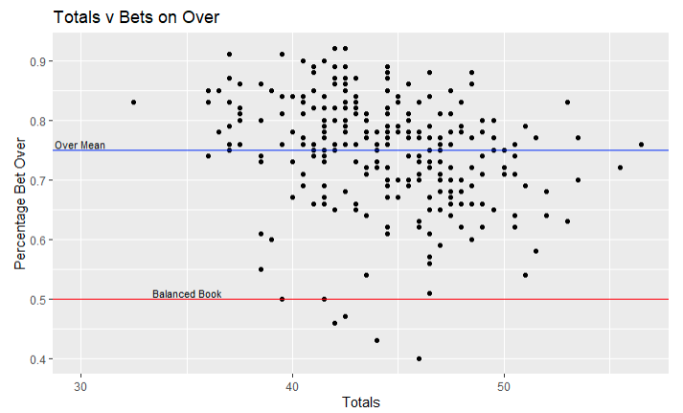
Leveraging the Unbalanced Book
Using the imbalance in the market we will investigate the Totals market to test for any possible profitable strategies
In doing so we will test both tail ends of the Totals distribution using the Q1 and Q3 as the cutoff for each tail
A t-test will be run with the null hypothesis of mean bet hit less than or equal to 52.4% (expected win percentage for profits in 11/10 priced markets

Slide 4
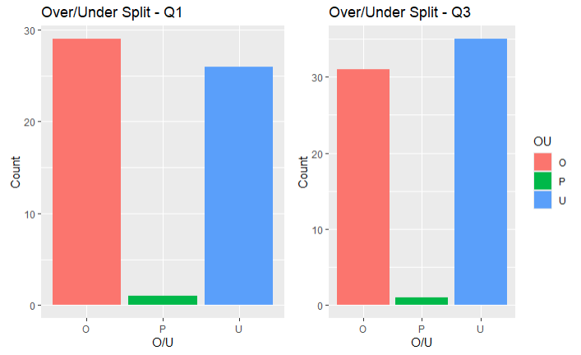
Totals Examination
Data | Market | Mean Success Rate | P-value
Q1 | Over | 51.8% | 0.5362
Q1 | Under | 46.4% | 0.8108
Q3 | Over | 46.3% | 0.8393
Q3 | Under | 52.2% | 0.5104
The table above includes the results for the Hypothesis testing
From the results we fail to reject the null hypothesis of no profitability
Further examination into the Over in Q1 and the Under in Q3 could provide a profitable strategy
Examining the histogram to the left shows that there isn’t much of a difference in the rates the Over and Under occur in the NFL during this time

